Slide 1


HOTEL MANAGEMENT SYSTEM
Presented by
THARUN KUMAR. M - 2303811710621114

Slide 2
Agenda
Problem identification
Objective
Block diagram
Data structures used
Modules
Advantages of the proposed system
Output(screen shot)

Slide 3

Problem identification
In a hotel management system,
one of the primary challenges is to efficiently manage the menu list. This includes adding new items, updating the availability of existing items, and deleting items that are no longer offered.
A manual process can be time-consuming and prone to errors, affecting the overall customer experience and operational efficiency.

Slide 4
Objective
To create a simple, user-friendly hotel management system to manage the menu list.
The system will allow users to:
View the current menu items with their prices and availability.
A hotel or restaurant setting. The system will allow staff to view the menu, check food availability, place food orders, and manage table occupancy. By using dynamic data structures, the system ensures flexibility and efficiency in handling food items and table statuses.

Slide 5
Architecture of the proposed system
1.Views menu list of foods in the format
Name of item – price – availability
-Display menu list
-Get user inputs as numbers
Select choices
2. Check availability
It will gets numbers as the input display whether the available or remaining items in the hotel.
1.Veiw menu
2.Check availability
3.Order food
4. Find an table
5. Check for favour table
3. Order food
This acces to place a particular food
And display remaining food items.
4. Find a table:
It will lot a table number in a hotel(Max 30 tables)
5. Free a table:
By giving your favour table number
It wiil check whether table is free or not

Slide 6
Data structures used
Singly Linked List:
FoodItem: Represents each food item on the menu.
Fields: char name[30], float price, int quantity, FoodItem* next
Operations: Adding food items, viewing the menu, checking availability, and
ordering food.
Array:
Table: Represents tables in the restaurant.
Fields: int tableNumber, int isOccupied
Operations: Initializing tables, finding empty tables, occupying tables,
and freeing table

Slide 7
Modules
Module 1: Food Item Management
Adds a new food item to the end of the linked list representing the menu. If the list is empty, it sets the new item as the head.
Deallocates the memory used by the linked list to prevent memory leaks.
Module 2: Menu Display and Availability Check
Traverses the linked list and prints out the details (name, price, quantity) of each food item in the menu. searches for a specific food item in the linked list by its name and prints its details if found. If the item is not found, it indicates so
Module 3: Food Ordering
searches for a specific food item in the linked list and reduces its quantity by the specified amount if available. It prints the order details and remaining quantity. If the quantity is insufficient, it notifies the user.
Module 4: Table Management
Iterates through the array of tables and returns the number of the first unoccupied table. If no tables are available, it returns -1.

Slide 8
Advantages of proposed system
Efficiency: Streamlines the process of managing the menu list, making it quicker and more efficient.
Accuracy: Reduces errors associated with manual menu management.
Scalability: Can handle up to 100 menu items, which is sufficient for most small to medium-sized hotels.

Slide 9
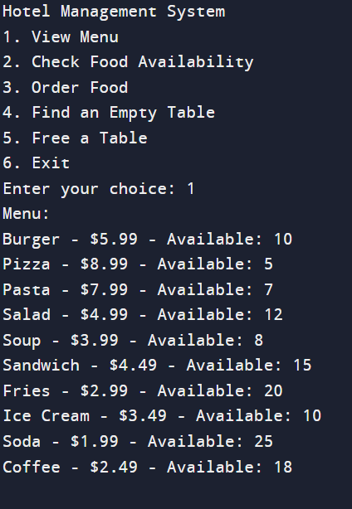
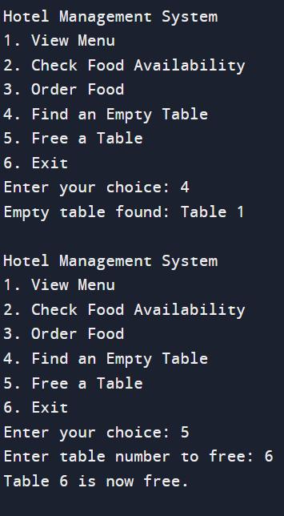
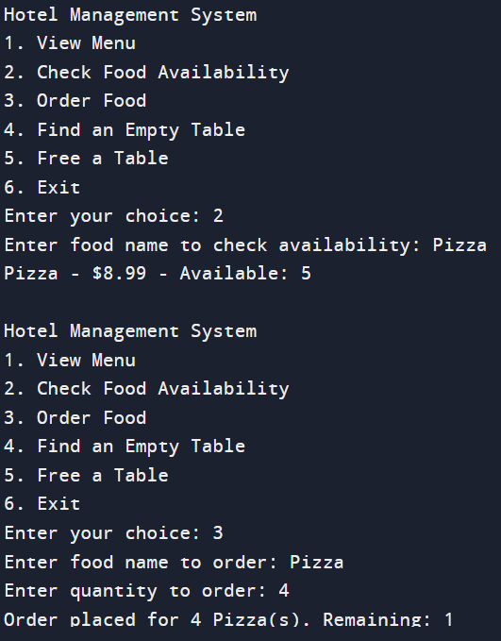
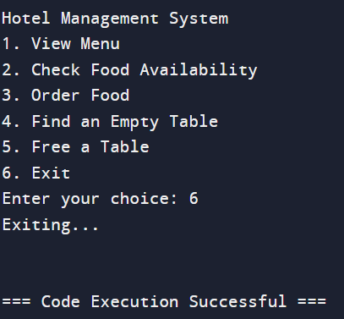
OUTPUT

Slide 10
Queries
THANK YOU

